Slide 1
Data Mining Final Project: The Mining Mavericks
Durga M Dash, Jacob K Shaw, and Saurav S Borah

Slide 2
Overview of Problem
Objective: Develop a predictive model for bankruptcy prediction
Data: 64 predictors, 10,000 data points

Slide 3
Model Exploration and Selection Criteria
Tried many different models:
Logistic Regression, Adaptive Lasso, SVM, Random Forest, Bagging, NN, etc.
Lot of Trial and Error with different parameters
Utilized Ensemble Node which boosted results
Compared the ROC index values on the validation set to select best models
Ultimately, decided on Gradient Boosting and Neural Networks
Ability to handle complex data relationships and identify intricate patterns

Slide 4
Model 1: HP Neural and Gradient Boosting
HP Neural:
Input Standardization: Z-Score
Architecture: User-Defined
No. of Hidden Layers: 5, No. of Neurons/Layer: 12/14
Creates a more complex architecture
Number of Tries: 8
Retrained network using different initial weights
ROC Index (on Validation set): 0.954
Performance:
Public Score: 0.9299
Gradient Boosting:
N Iterations: 430
Max Branch = 2, Max Depth = 2
ROC Index (on Validation set): 0.931
Performance:
Public Score: 0.9341

Slide 5
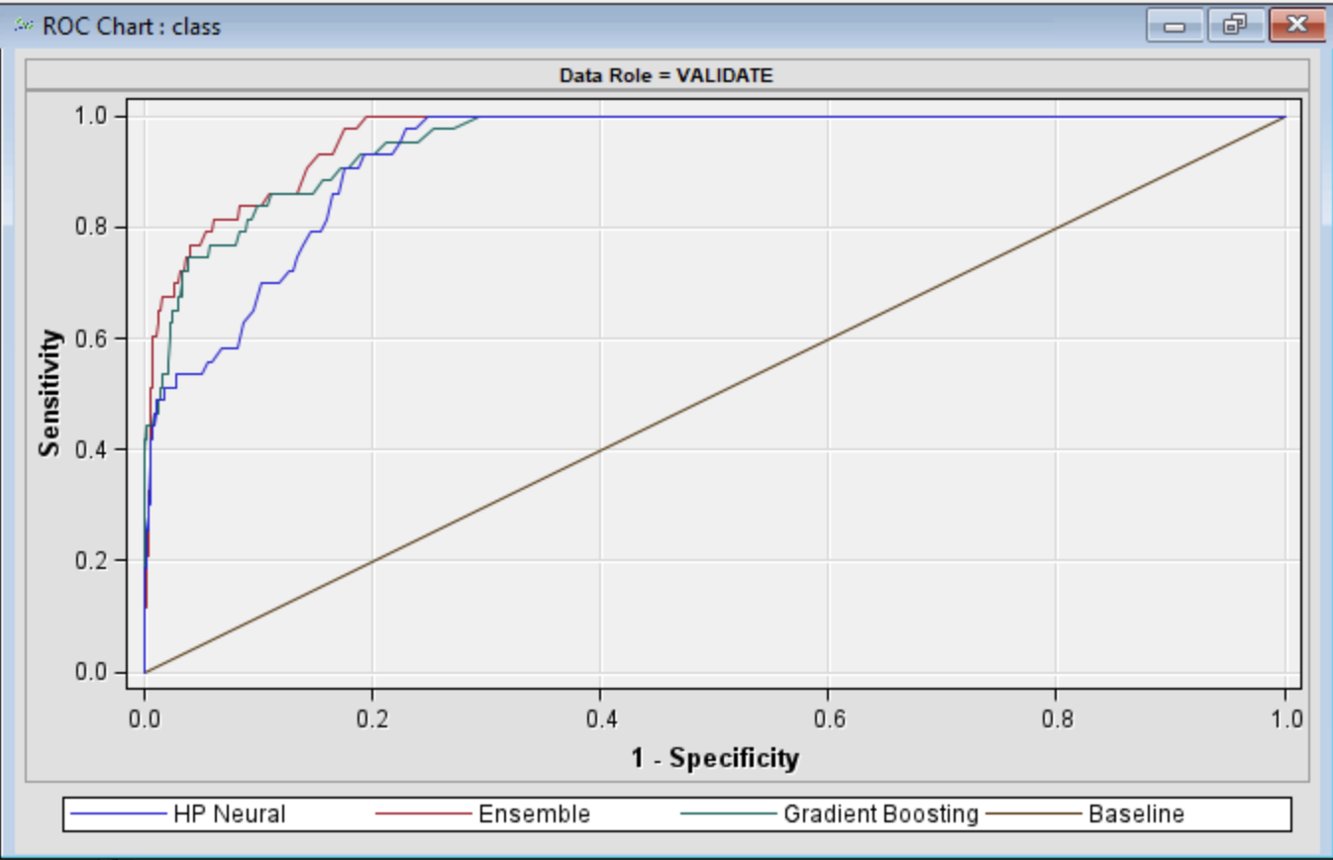
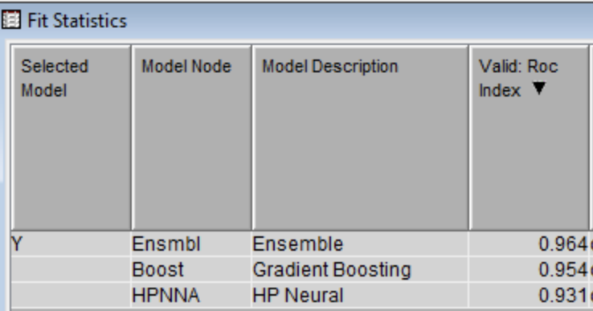
Model 1: HP Neural and Gradient Boosting
Ensemble Node:
Predicted Values: Soft Voting method
Soft voting uses averages of posterior probabilities from each model to predict new probabilities.
Performance:
ROC Index(on Validation set): 0.964
Public Score: .95117
Private Score: .95448

Slide 6
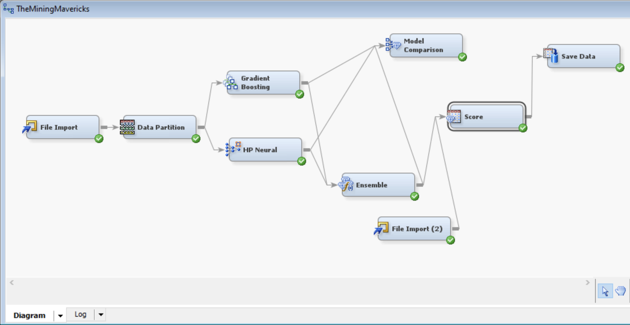
Model 1: HP Neural and Gradient Boosting
SAS EM Diagram:

Slide 7
Model 2: Neural Network and Gradient Boosting
Neural Network:
Continue Training: Yes
Model Selection Criteria: Profit/Loss
Minimizes loss for cases in validation set
ROC Index (on Validation set): 0.919
Performance:
Public Score: 0.92384
Gradient Boosting:
N Iterations: 200
Max Branch = 2, Max Depth = 10
Shrinkage= .001
Lets model learn slowly, reduce overfitting
ROC Index (on Validation set): 0.887
Performance:
Public Score: 0.91878
Notes:
The ROC plot displays both TPR (TPR = 1-FNR) and FPR simultaneously, summarized over all possible thresholds. Sometimes we use the area under the curve (AUC) to summarize the overall performance. Higher AUC is better

Slide 8
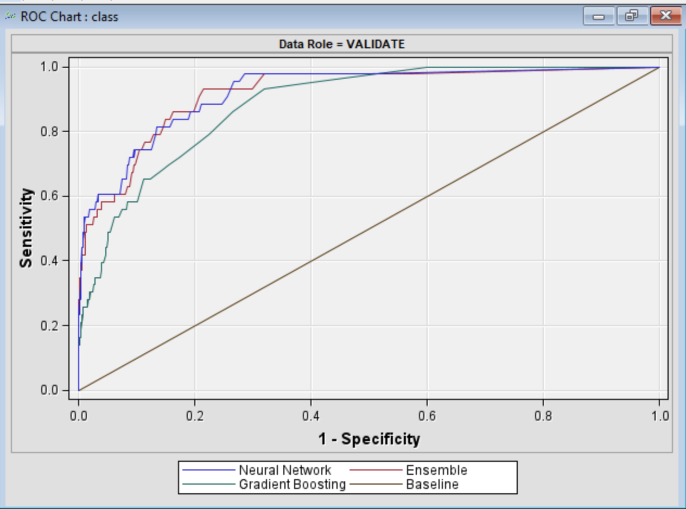
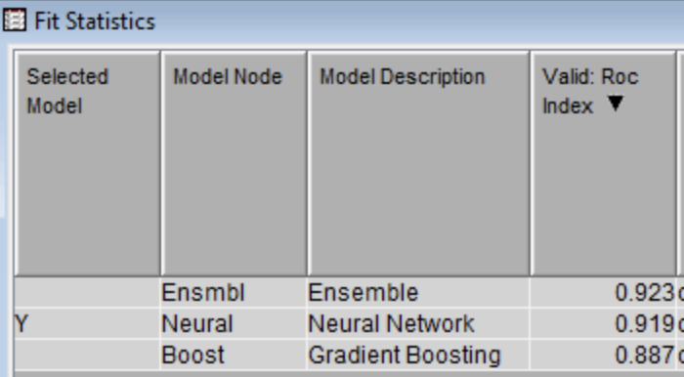
Model 2: Neural Network and Gradient Boosting
Ensemble Node:
Predicted Values: Average method
Averages posterior probabilities from models to form prediction
Performance:
ROC Index(on Validation set): 0.923
Public Score: .9414
Private Score: .9485
Notes:
To improve accuracy and reliability, an Ensemble node was employed using the average ensemble method.
This approach combined predictions from both models, mitigating biases and enhancing overall performance by leveraging the strengths of multiple algorithms.

Slide 9
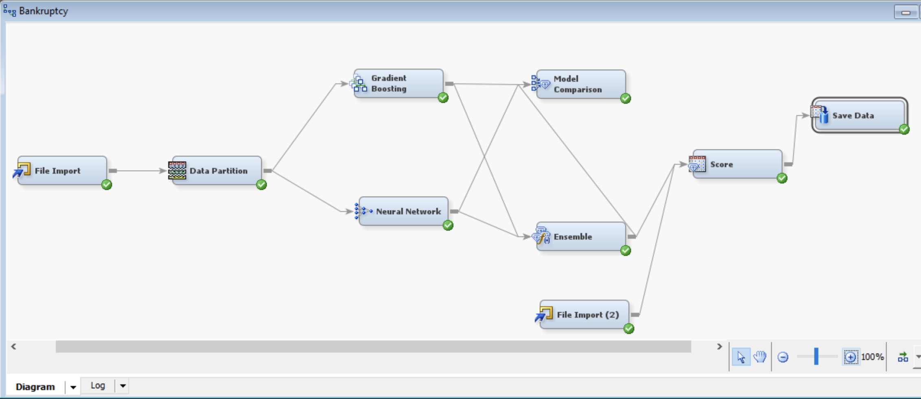
Model 2: Neural Network and Gradient Boosting
SAS EM Diagram:

Slide 10
Lessons Learned
Lessons
Learned to use the Ensemble node which aggregates predictions generated by the selected models according to the specified ensemble method which in our case is the average value method.
With the number of hidden layers and neurons in the Neural network models, the accuracy of the model improved significantly.
Unexpected findings or insights gained
With the change in the random seed of the validation set, the ROC index value varied significantly.
The use of the filter and impute nodes in the model increased the prediction error.

